Slide 1
Student Name
Final Project
Aravindhan
3/21/2024 Annual Review

Slide 2
PROJECT TITLE
Iris flower classification (logistic regression)
3/21/2024 Annual Review

Slide 3

Agenda
Problem statement
Project overview
Who are the end user
Your solution and its value proposition
Your wow in your solution
Modeling
result
3/21/2024 Annual Review

Slide 4

PROBLEM STATEMENT
The task at hand is to develop a logistic regression model for accurately classifying iris flowers into one of three species: setosa, versicolor, and virginica. The dataset comprises four features: sepal length, sepal width, petal length, and petal width. Each instance in the dataset is labeled with the corresponding species.
3/21/2024 Annual Review

Slide 5

PROJECT OVERVIEW
The objective is to build a robust predictive model that can accurately classify iris flowers based on their features. This model will be used for real-world applications such as species identification in botanical studies, horticulture, and environmental monitoring.
3/21/2024 Annual Review

Slide 6

WHO ARE THE END USERS?
End Users:
1. Botanists and Biologists
2. Horticulturists and Gardeners
3. Environmentalists
4. Educational Institutions
5. General Public
3/21/2024 Annual Review

Slide 7
YOUR SOLUTION AND ITS VALUE PROPOSITION
Our solution offers a straightforward yet effective method for classifying iris flowers into different species based on their physical characteristics.
Value Proposition:
Accuracy and Reliability
Ease of Use
Efficiency
Versatility
Insightful Interpretation
3/21/2024 Annual Review

Slide 8
THE WOW IN YOUR SOLUTION
Implementing logistic regression for Iris flower classification:
Load the Data
Prepare the Data
Train the Model
Test the Model
Evaluate the Model
3/21/2024 Annual Review
8

Slide 9
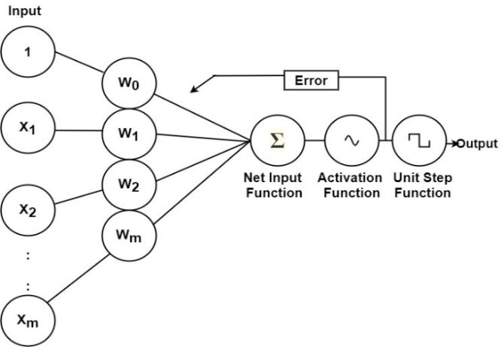
MODELLING
3/21/2024 Annual Review
9

Slide 10
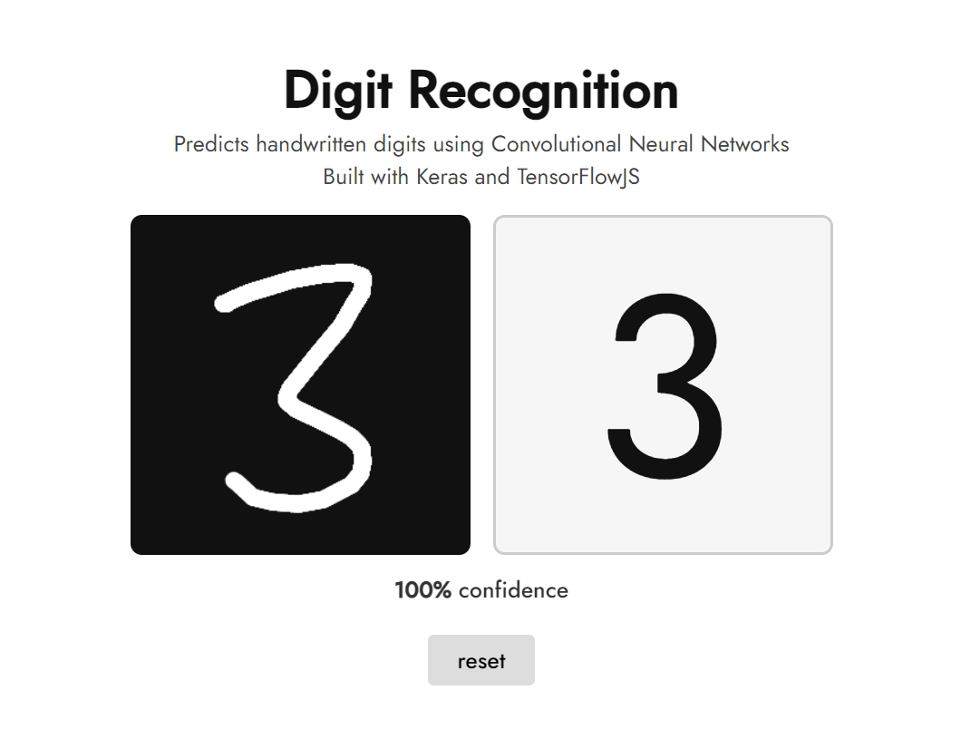
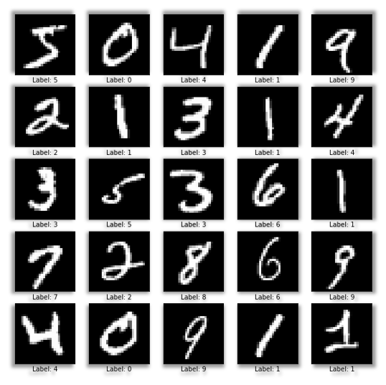
RESULT
10

